Slide 1

YouTube Data Harvesting and Warehousing using SQL, MongoDB and Streamlit
DOMAIN : SOCIAL MEDIA

Slide 2
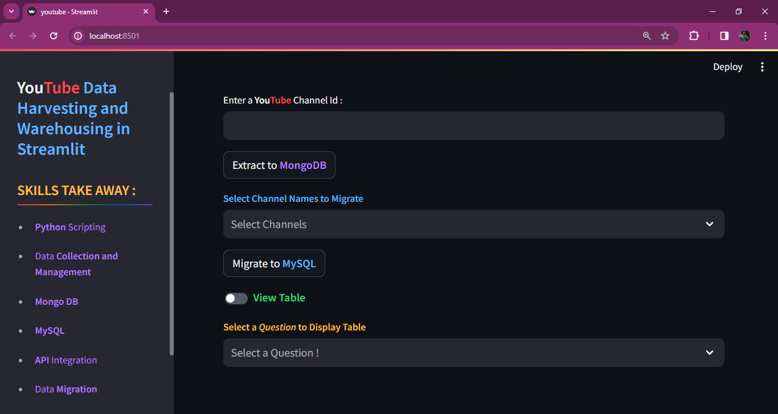
Streamlit Web Application Interface :

Slide 3
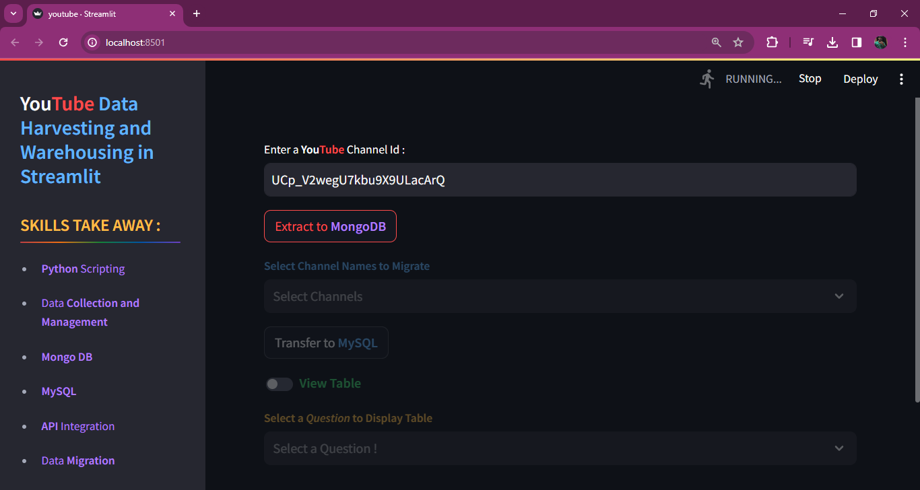
Entering YouTube Channel ID and Uploading the channel data into MongoDB

Slide 4
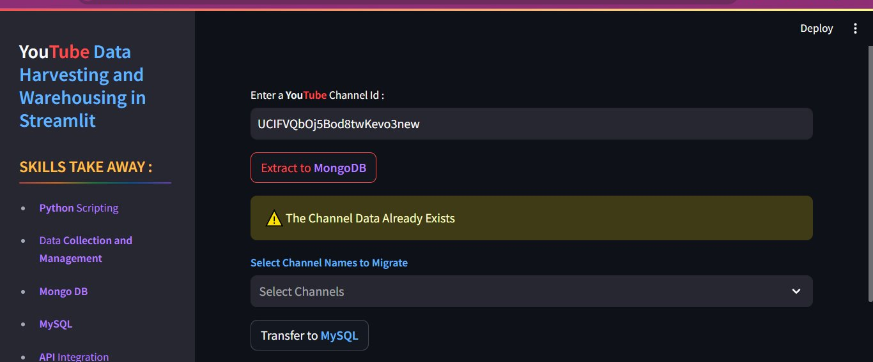
When the channel details are already extracted, Pop up shows up that the details already exists

Slide 5
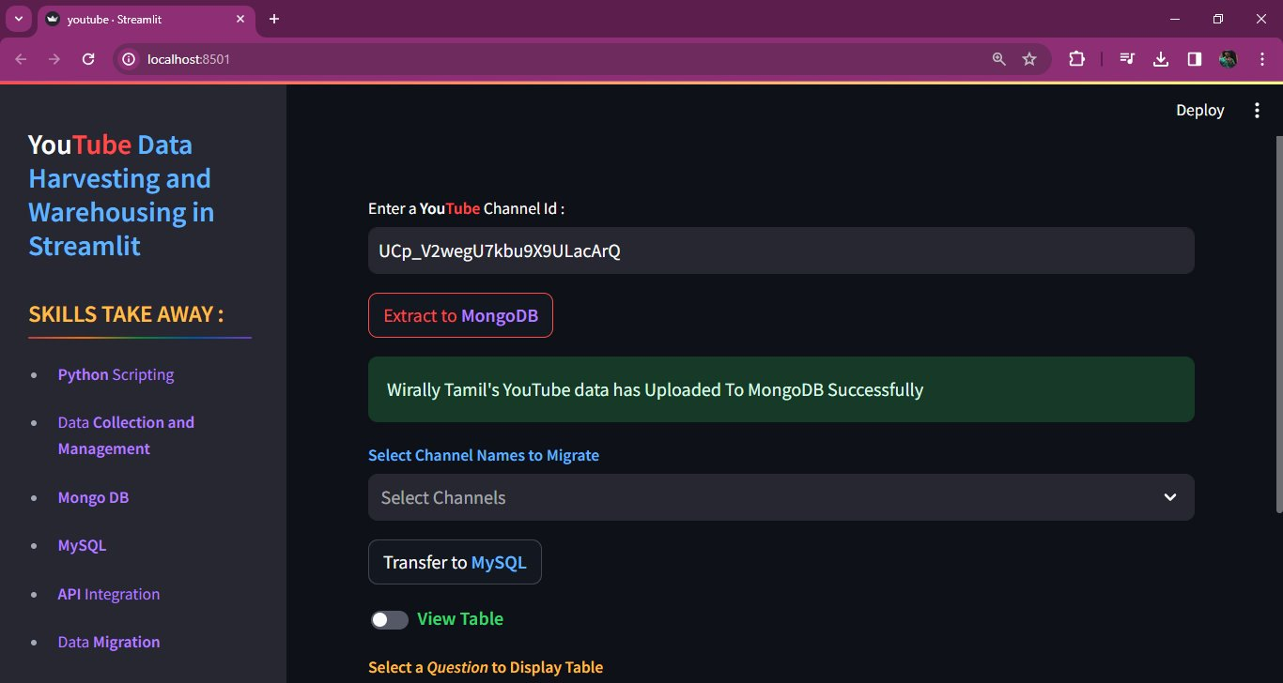
When a channel detail has uploaded Successfully to MongoDB Pop up shows

Slide 6
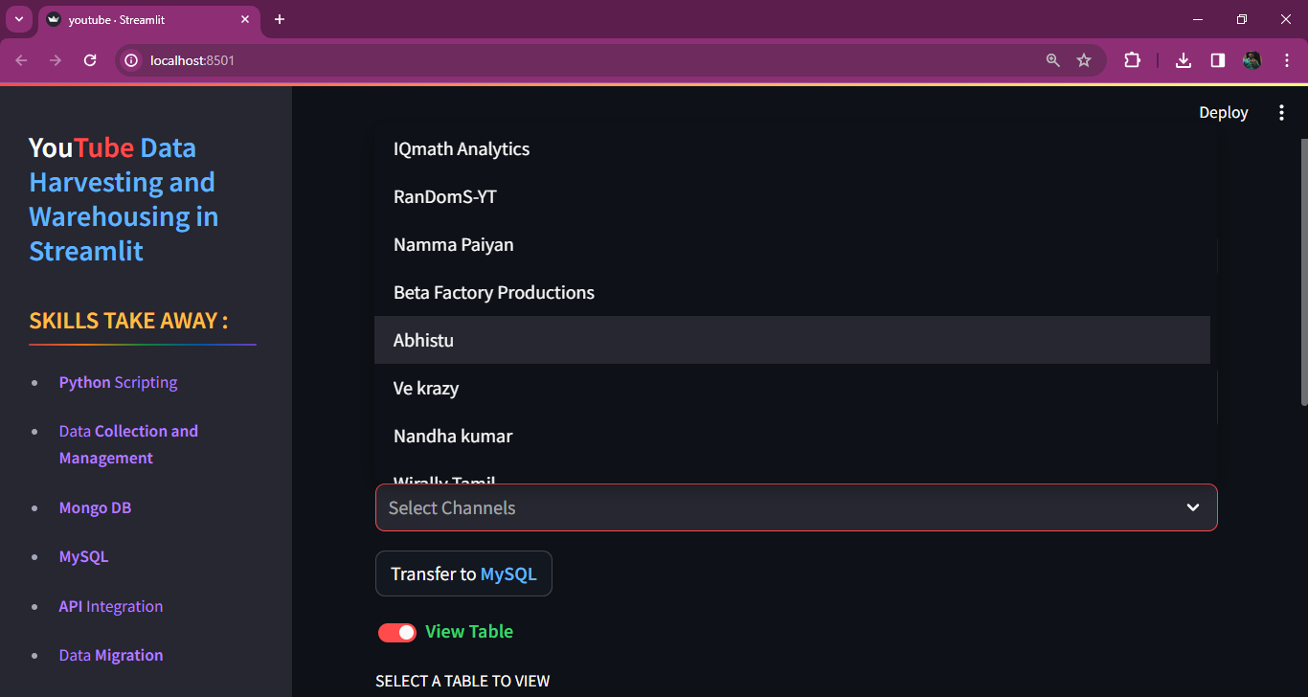
Selecting the channels to migrate that particular channel data from Mongo Db to MySQL

Slide 7
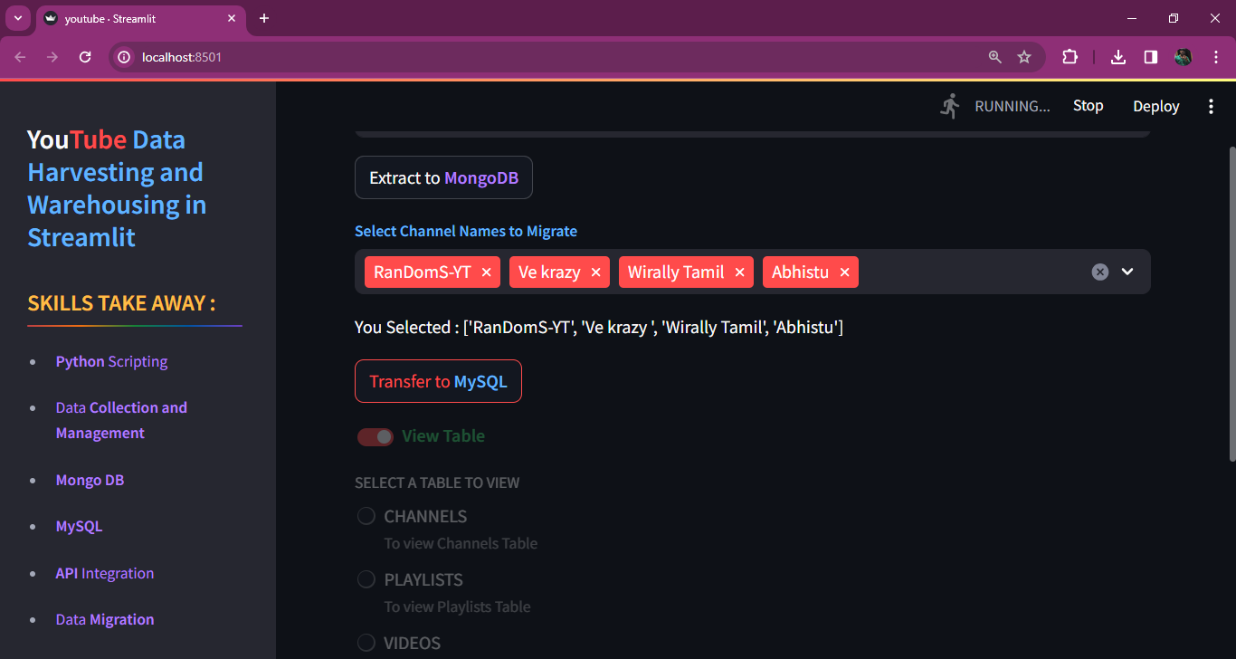
Choosing Multiple Channels to migrate

Slide 8
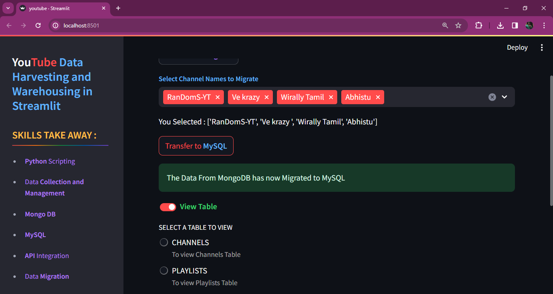
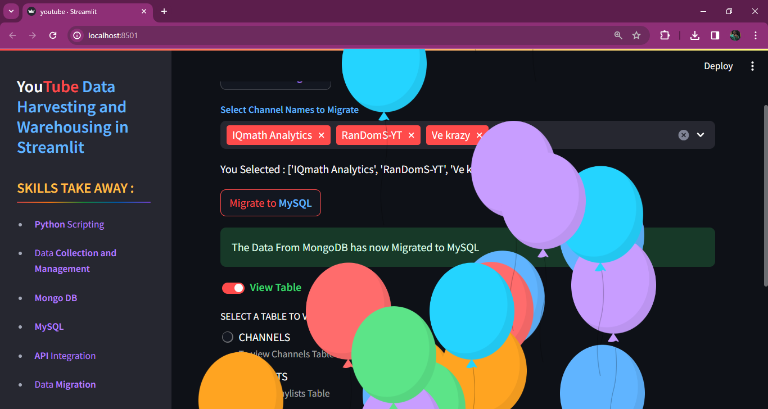
Pop Up and balloons when successful data Migration

Slide 9
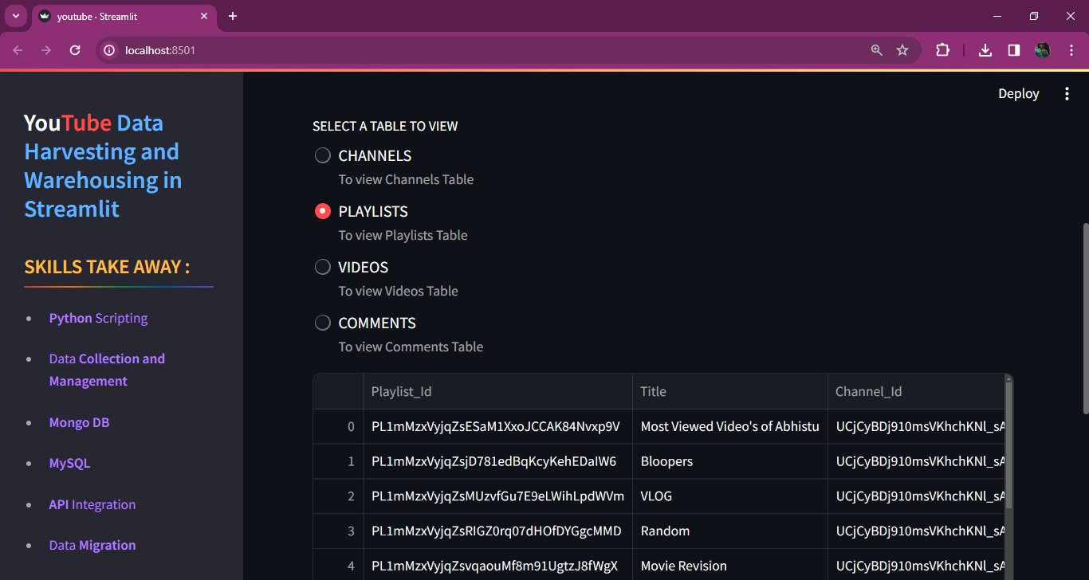
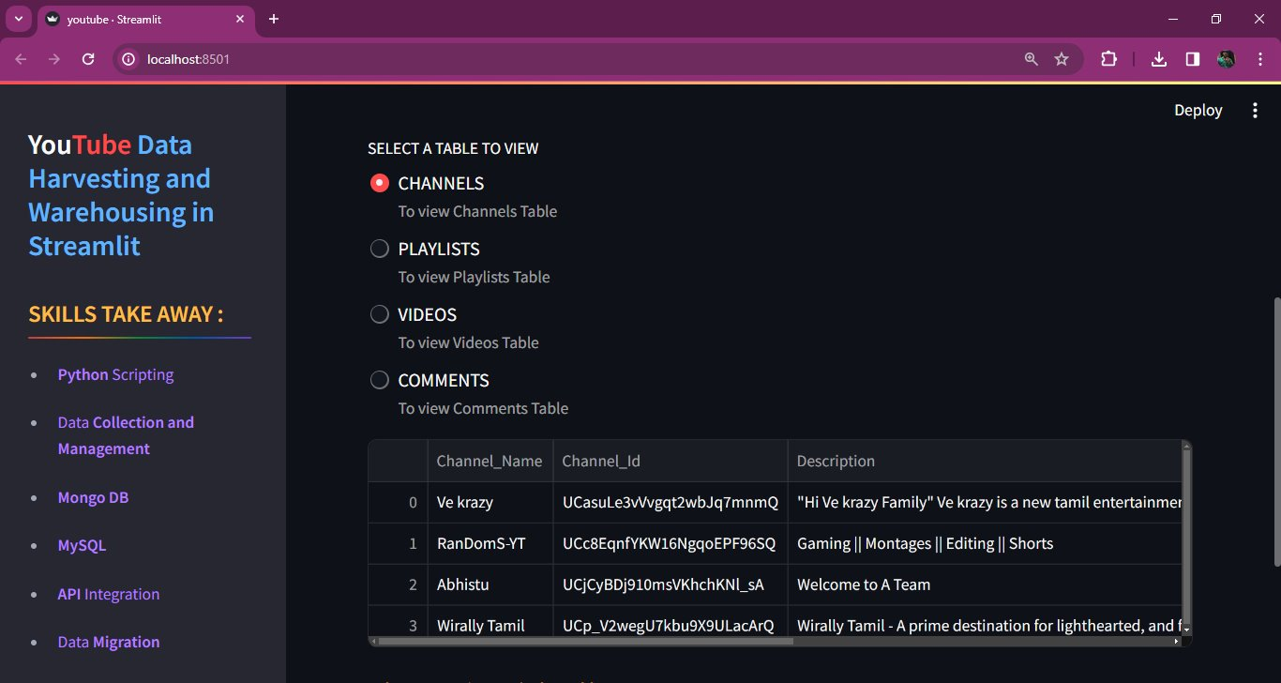
Viewing Tables
Channels
Playlists
Videos
Comments

Slide 10
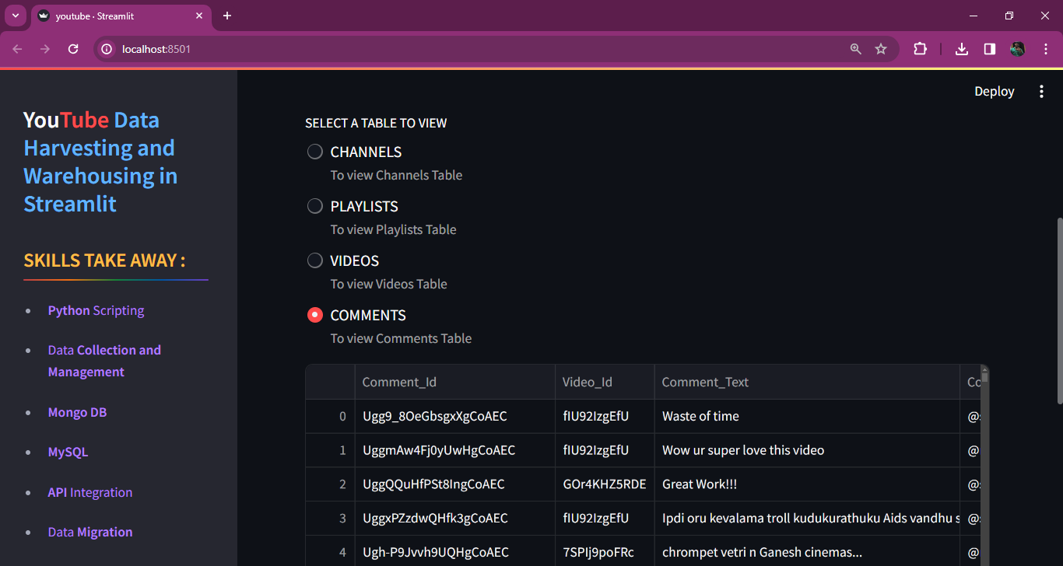
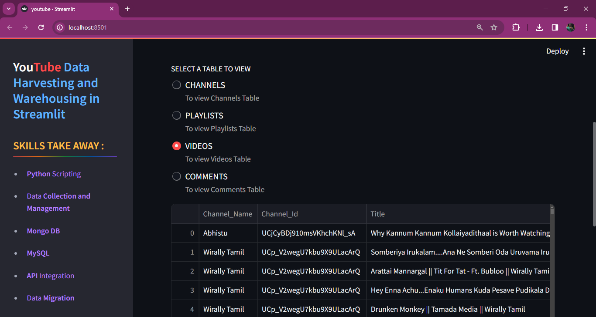

Slide 11
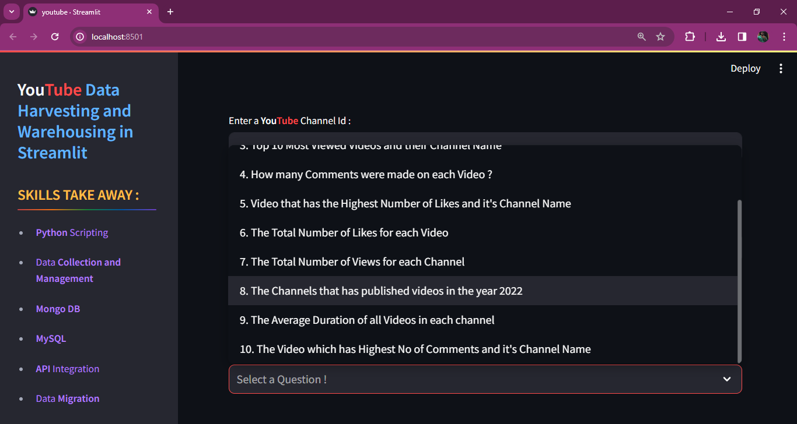
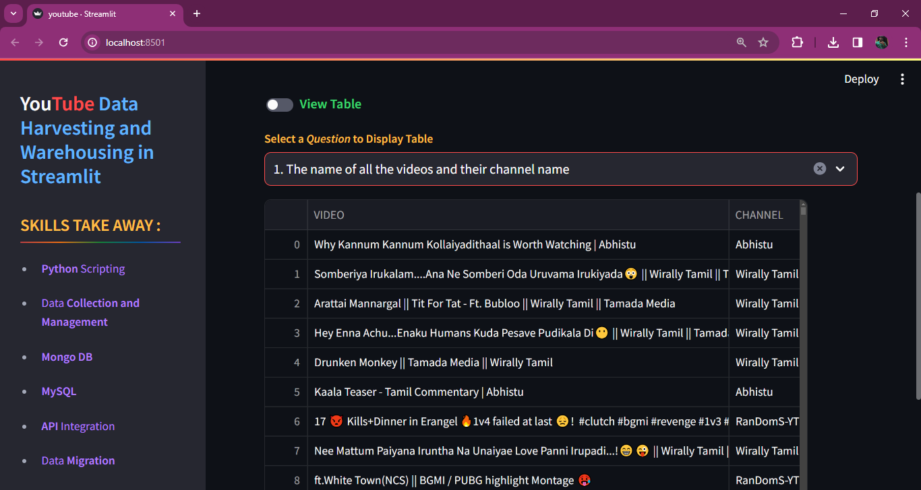
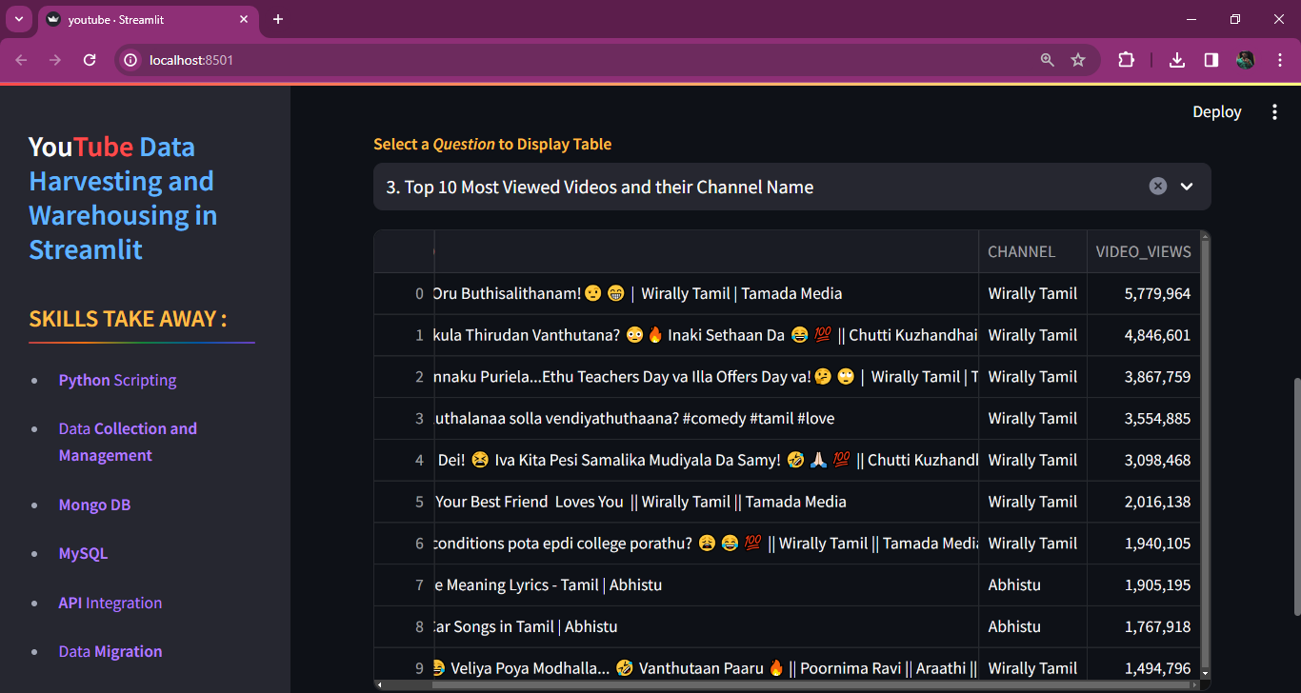
10 Drop down Questions To select get relevant Tabular Output

Slide 12


